Slide 1

A* Pathfinding Algorithms Comparison
Interactive Grid Navigation Analysis
Masters Team

Slide 2

CONTENT
01
02
Project Overview
Algorithms Implementation
03
Results and Analysis

Slide 3


Project Overview
01
Our project focuses on the A* pathfinding algorithm, using it as the main reference point for comparing other classic search methods (Dijkstra, Greedy Best-First, BFS, DFS) on 2D grid maps. We provide both console and Tkinter GUI modes to run A* on different maps, visualize the resulting paths, and measure metrics such as path length, expanded nodes, and execution time. Other algorithms are used mainly to highlight how A* combines optimality and efficiency, confirming that A* finds optimal paths on unweighted grids while often expanding fewer nodes than uninformed methods.

Slide 4



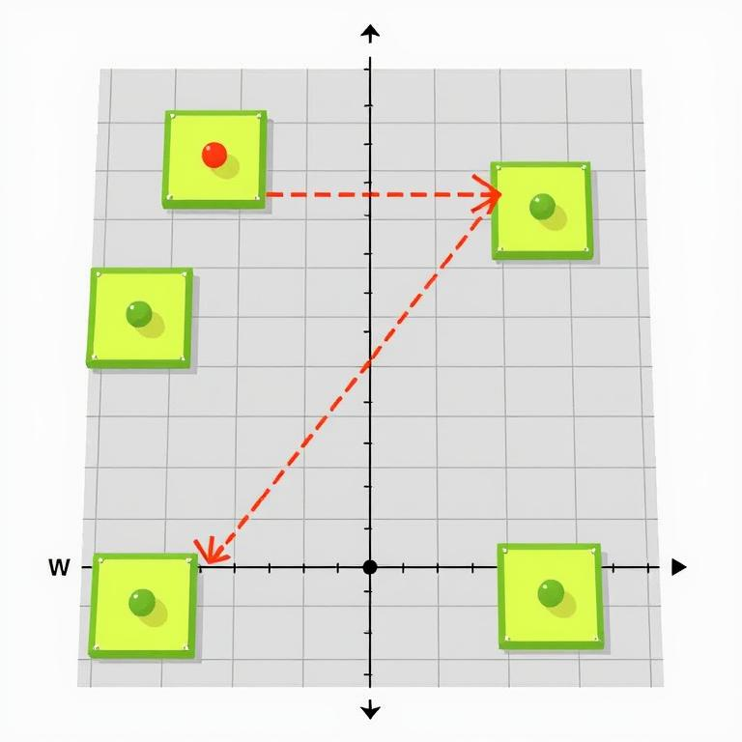
AI Pathfinding on 2D Grids
Grid-based pathfinding
Key algorithms compared
Finding optimal routes between start and goal cells on 2D grids with obstacles using four-directional movement.
A*, Dijkstra, Greedy Best-First, BFS, and DFS algorithms evaluated for path optimality and efficiency.
02
01
03
Visualization approach
04
Movement constraints
Tkinter GUI displays grids, paths, and performance metrics including path length, expanded nodes, and execution time.
Four-directional movement (up, down, left, right) with walls blocking paths and grid boundaries limiting travel.

Slide 5


System Architecture
File Structure
Component Integration
Execution Flow
Data Management
Main components include main.py, gui.py, algorithms.py, grid.py, and heuristics.py working together for pathfinding visualization.
GUI calls algorithms and grid modules to display pathfinding results with clear separation of concerns.
User selects map and algorithm, system processes request, visualizes results with metrics in the interface.
Grid representation handles walls, paths, start/goal positions while algorithms process navigation data.
1
2
3
4

Slide 6
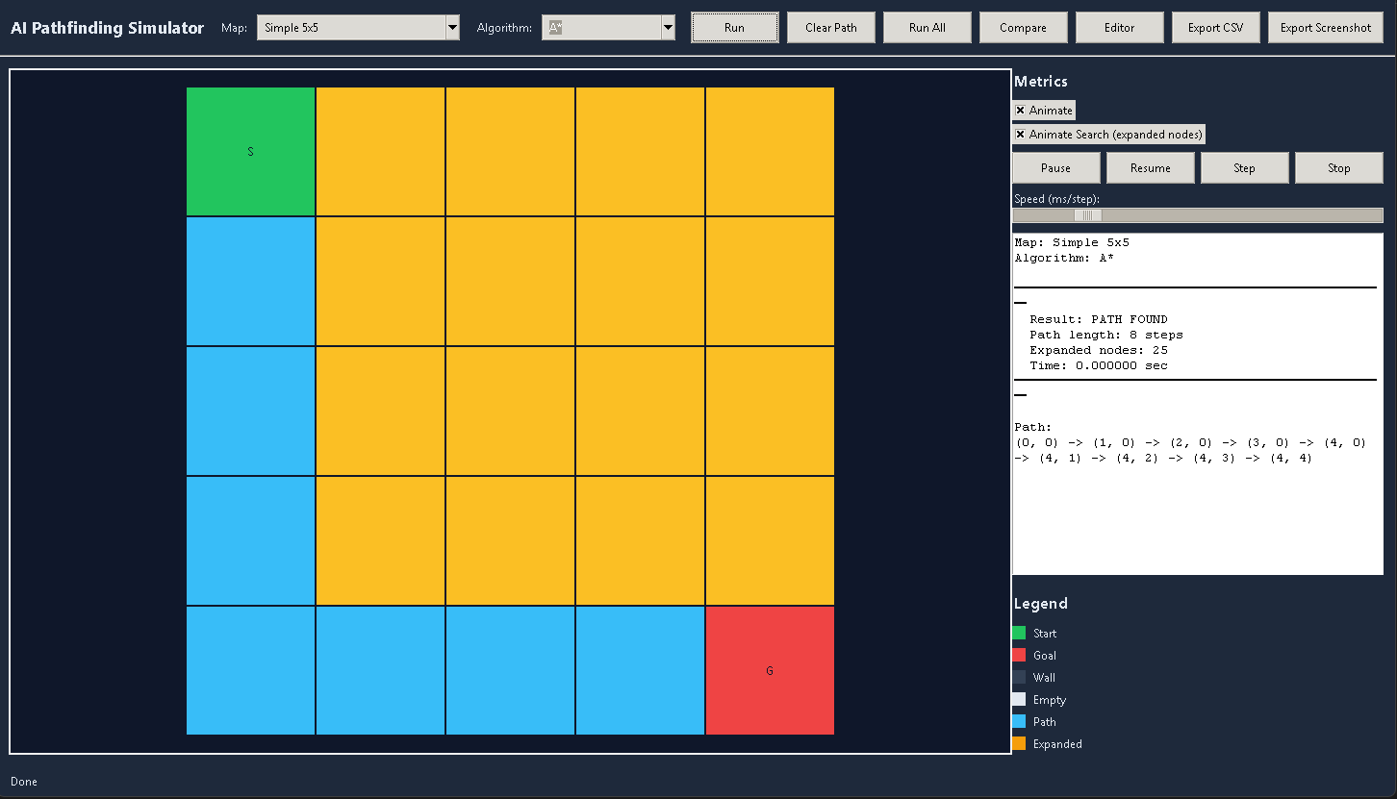


GUI Features
Map Selection
Grid Visualization
Choose from various predefined maps including simple grids, mazes, and special demonstration scenarios.
Clear display of walls, start and goal positions with distinctive path overlay when solution exists.
Algorithm Selection
Metrics Panel
Select between A*, Dijkstra, Greedy Best-First, BFS, or DFS algorithms for pathfinding comparison.
Shows path status, length, expanded nodes count and execution time for performance analysis.

Slide 7
GUI Features
Map Selection
Grid Visualization
Choose from various predefined maps including simple grids, mazes, and special demonstration scenarios.
Clear display of walls, start and goal positions with distinctive path overlay when solution exists.
Algorithm Selection
Metrics Panel
Select between A*, Dijkstra, Greedy Best-First, BFS, or DFS algorithms for pathfinding comparison.
Shows path status, length, expanded nodes count and execution time for performance analysis.

Slide 8
02
Algorithms Implementation

Slide 9




A* and Dijkstra
03
01
Key Differences
A* Algorithm
A* uses heuristics for efficiency, Dijkstra explores uniformly, both optimal on unweighted grids.
Combines g(n) + h(n), uses Manhattan heuristic, optimal on unweighted grids.
04
02
Performance Comparison
Dijkstra Algorithm
A* typically expands fewer nodes than Dijkstra, both find identical paths in unweighted environments.
Uniform-cost search approach, guarantees optimal paths, complete algorithm.

Slide 10
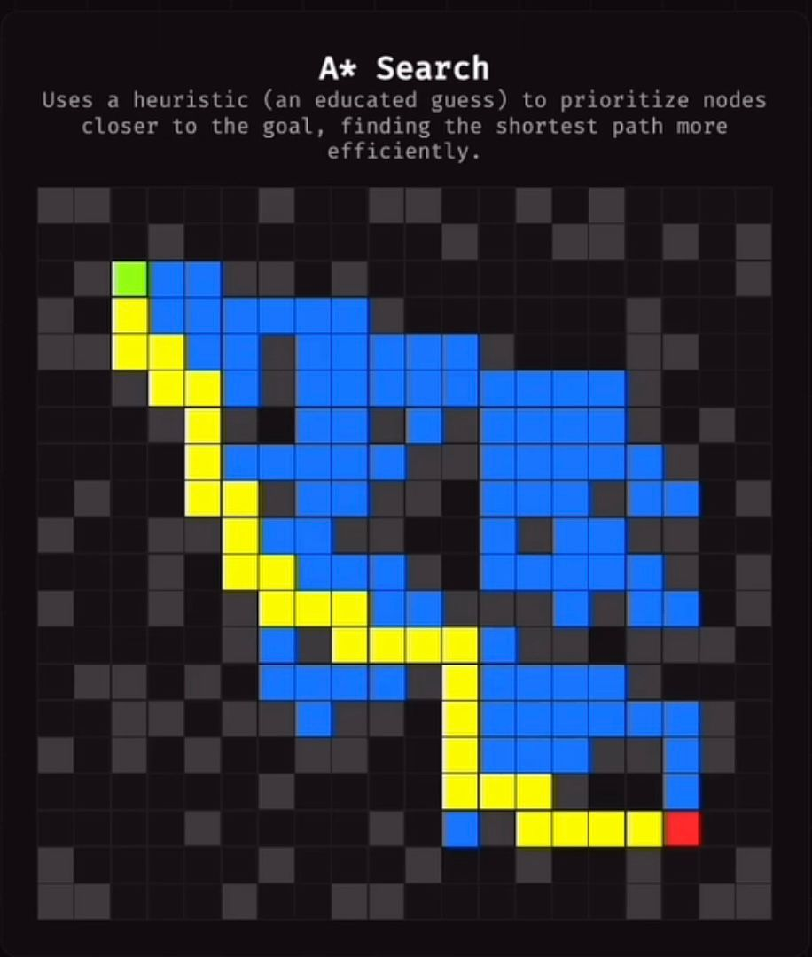
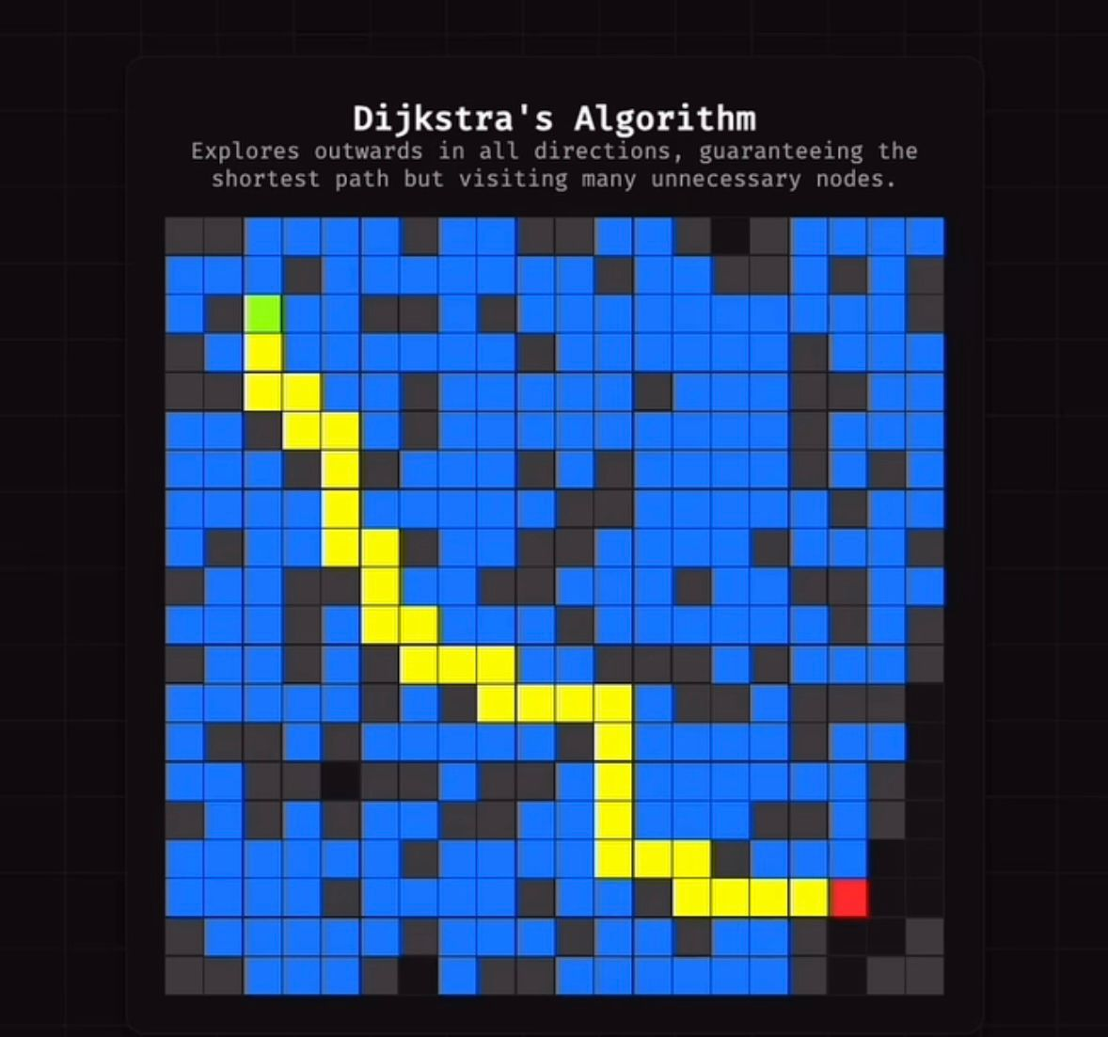
A* and Dijkstra

Slide 11
Greedy Best-First Search
Heuristic-Only Search
Fast But Not Optimal
Heuristic Options
Performance Characteristics
Uses only h(n), ignoring path cost g(n), focusing exclusively on estimated distance to goal.
Expands fewer nodes than A*, sacrificing guaranteed optimality for speed in pathfinding.
Supports both Manhattan and Euclidean distance calculations through GUI dropdown selection.
Typically expands minimal nodes but may produce suboptimal paths in complex environments.

Slide 12
BFS and DFS
1
2
3
4
Breadth-First Search
Depth-First Search
Key Differences
Performance Comparison
Explores level-by-level, guarantees optimal paths on unweighted grids, expands many nodes for completeness.
Explores deep paths first, not optimal, can produce significantly longer routes, uses less memory.
BFS finds shortest paths but explores more nodes; DFS explores fewer nodes but produces longer, non-optimal paths.
BFS expands more nodes initially but guarantees optimality; DFS performs poorly in deep trap scenarios.

Slide 13
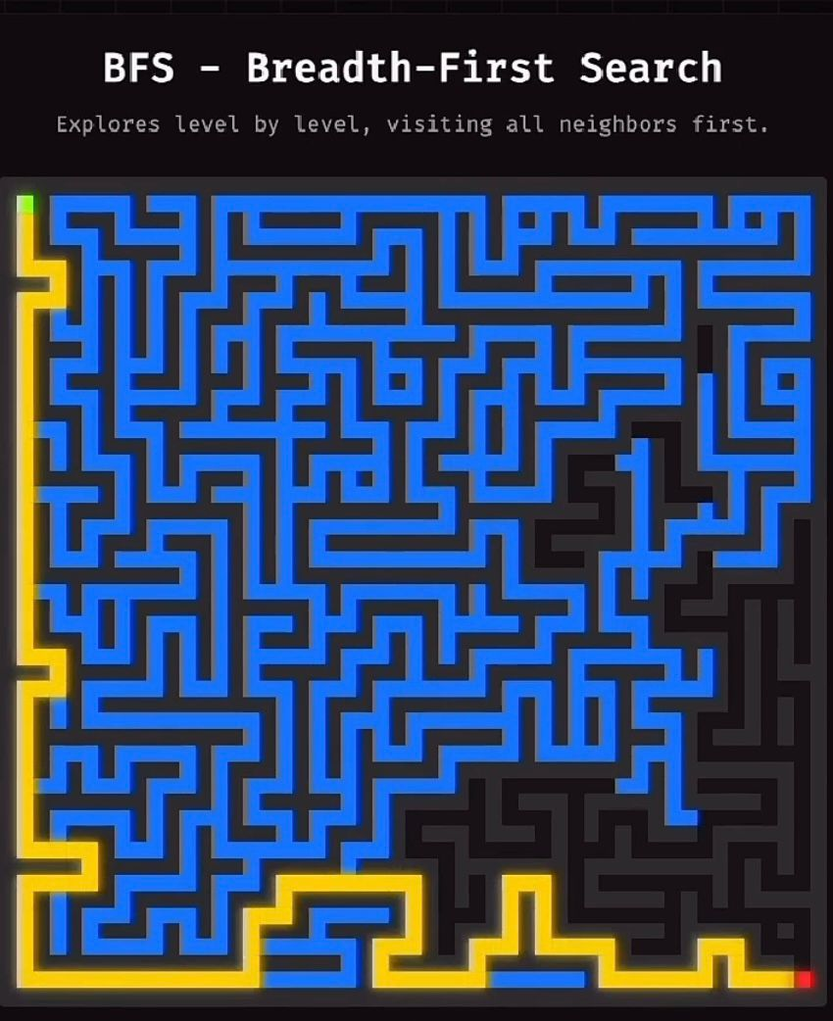
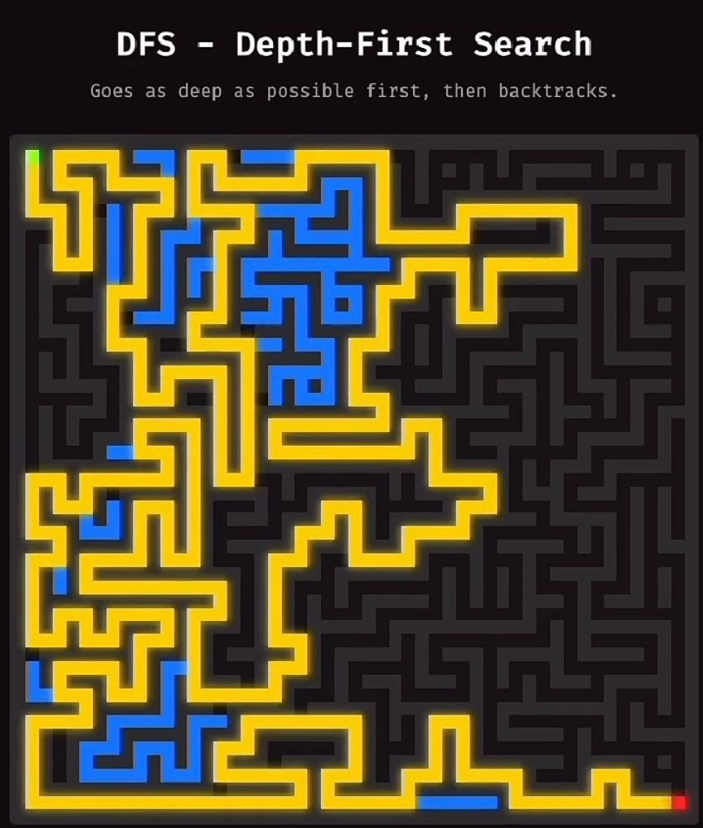
BFS and DFS

Slide 14




Algorithm Comparison Metrics
Path Quality
Expanded Nodes
Time Complexity
Algorithm Behavior
Measures optimal path length and solution completeness across algorithms.
Counts nodes explored during search, indicating algorithm efficiency and memory usage.
Measures execution speed in seconds, critical for real-time applications.
Evaluates performance in special cases like mazes, traps and no-path scenarios.

Slide 15
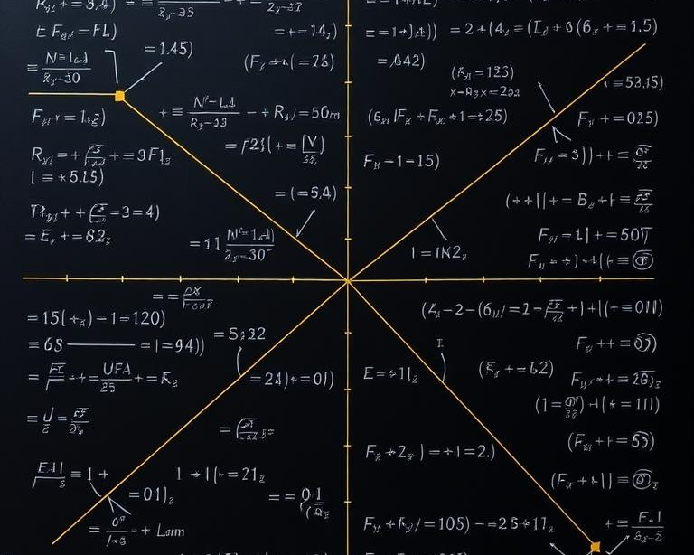
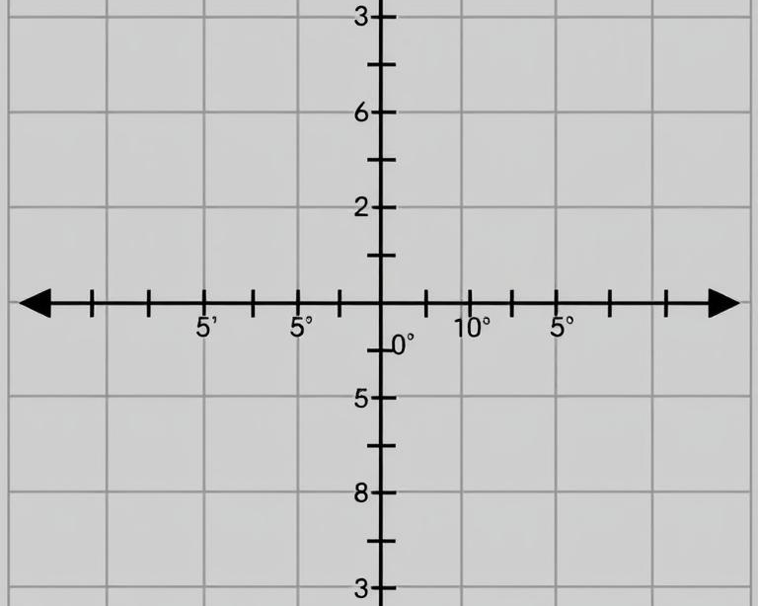
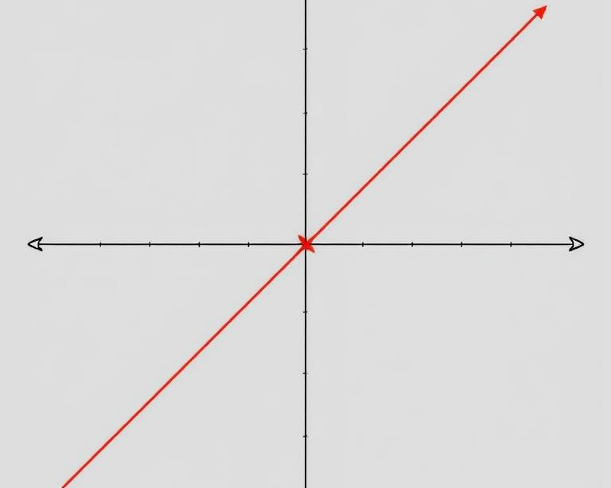
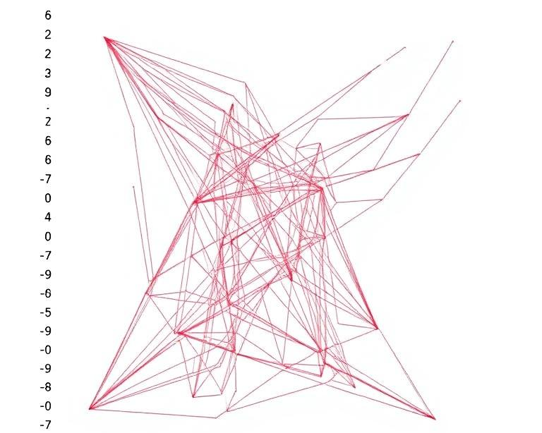
Heuristic Functions
What are heuristic functions?
Manhattan Distance
Euclidean Distance
Impact on Algorithms
Mathematical formulas estimating distance from current node to goal, guiding search algorithms toward efficient paths.
Calculates sum of horizontal and vertical distances, ideal for grid-based movement without diagonals.
Measures straight-line distance between points, suitable when diagonal movement is allowed.
Determines efficiency in A* and Greedy Best-First Search, balancing path optimality with computational speed.

Slide 16
03
Results and Analysis

Slide 17
Performance Tables
Algorithm Performance Comparison
Simple Map Results
Results showing path finding success, cost, and nodes expanded across five test maps.
A*, Dijkstra, BFS optimal with cost=8. Greedy uses fewer nodes. DFS produces longer paths.
Maze Performance
Special Test Cases
A*, Dijkstra, BFS find optimal path=18. Greedy expands only 19 nodes versus 77 for others.
All algorithms correctly identify no-path scenarios. DFS shows suboptimal behavior in trap maps.

Slide 18






Path Optimality Findings
Optimal Path Algorithms
Node Expansion Efficiency
DFS Path Quality
Greedy Algorithm Performance
A*, Dijkstra, and BFS consistently find shortest paths on unweighted grids, demonstrating reliable optimality.
A* expands fewer nodes than Dijkstra/BFS by using heuristics, while Greedy requires minimal expansion but sacrifices guarantees.
DFS consistently produces longer paths, showing 2-3x length in test maps compared to optimal algorithms.
Often matches optimal path length in test scenarios despite theoretical limitations, with significantly reduced node expansion.

Slide 19




Expanded Nodes Comparison
Expanded Nodes Comparison
Greedy's Efficiency
Shows how many grid cells each algorithm explores before finding path solution.
Consistently expands fewer nodes using heuristic-only approach, showing significant reduction across all test maps.
A* vs Dijkstra
BFS Exploration Pattern
Both expand similar nodes in unweighted grids, with A* slightly more efficient in complex mazes.
Expands nodes level-by-level, matching Dijkstra's count in unweighted grids while guaranteeing optimal paths.

Slide 20
Special Test Cases
03
01
Greedy Trap Map
Edge Cases
Demonstrates how Greedy can be misled by heuristics while A* finds optimal solution.
Special maps designed to test algorithm weaknesses and highlight performance differences.
04
02
DFS Deep Trap
No Path Map
Shows DFS inefficiency with cost=32 versus BFS cost=14 in specially designed maze.
Tests algorithm robustness when goal is unreachable, all correctly report "no path found."

Slide 21
Team Members Workload
Leader and Core Integration
Algorithm Specialists
Adham Sobhy manages GUI architecture, A* algorithm, final merge and quality assurance.
Yassin handles Dijkstra and validation, while Belal implements BFS/DFS algorithms with demonstration maps.
Improve GUI usability
Documentation and Analysis
Andrew focuses on interface polish and Greedy heuristic vs A*.
Ahmed manages packaging and instructions, while Mohamed handles performance analysis and presentation development.

Slide 22
Thanks！

